Slide 1
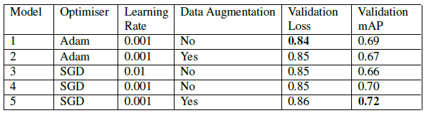
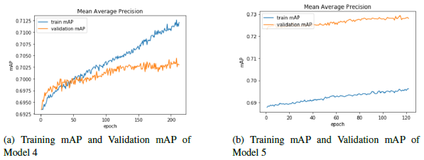
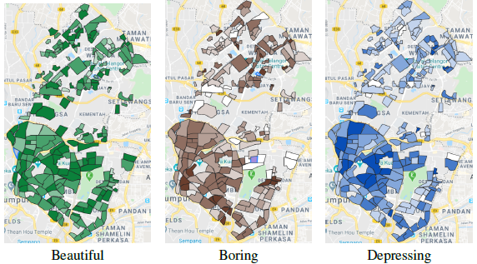
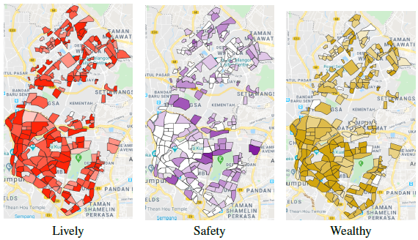
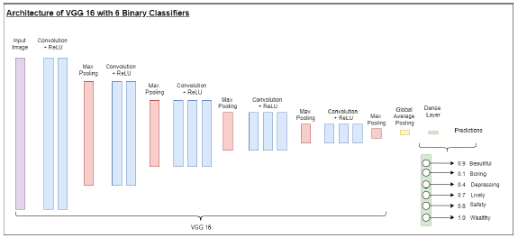
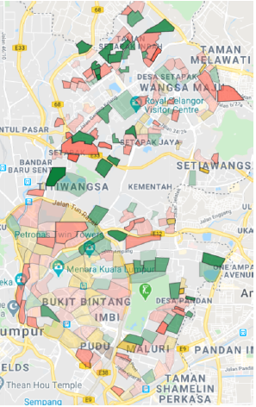



#1322: LEARNING URBAN PERCEPTION OF CITIES VIA STREET VIEW IMAGES
Lim Xin Qi, 1161303165
Supervisor: Dr. John See Su Yang, Moderator: Dr. Wong Lai Kuan
Abstract
Implementation, Findings & Result
The perception of humans, particularly of a city, is commonly coined "Urban Perception". In the past, the effort to quantify the urban perception of a city was tremendously tedious since the studies were mostly carried out manually. In this paper, a more efficient and data-driven way of urban perception study was carried using deep learning on city streetscapes to predict the perceptual scores of neighbourhoods in Kuala Lumpur, Malaysia.
Training was done using different model settings while the architecture and weights used were all respectively VGG16 and Places365.
The batch size specified was also constantly 16. The validation loss and validation mAP are both taken at the point of the lowest validation loss.
Model 4 was chosen because it behaved more normally.
Choropleth Maps of 6 perceptual attributes
Predominance Map
Color encoding: Predominant attribute
Transparency encoding: Strength of predominance
Objectives
To identify and train a suitable deep learning model for a multilabelled classification task to predict the urban perception of a location given the Google Street View (GSV) image of that certain location.
To create an interactive neighbourhood-level visualisation on the predicted perceptual attributes.
Literature Review
Salesses et al. (2013) 's work is one of the initial approaches on collecting a large scale of street view data for urban perception studies.
Dubey et al. (2016) crowdsourced a new GSV dataset (Place Pulse 2.0). They implemented a Siamese-like CNN model to predict the winner in a pairwise comparison.
Using Place Pulse 2.0,
Zhang et al. (2018) trained a SVM classifier to classify 6 binarised perceptual attributes on each image.
Methodology
Dataset: Place Pulse 2.0 dataset (Dubey et al., 2016) - GSV images
Model Architecture: VGG 16 architecture, pretrained on Places 365 weight (Zhou et al., 2017)
Evaluation Metrics: mean average precision (mAP)
Mean of AP
Visualisation:
6 Choropleth Maps
1 Predominance Map
Predominant perceptual attribute of neighbourhoods
Strength of predominance:
Conclusion
In conclusion, a suitable deep learning model which achieved a validation mAP of 0.70 was identified and trained for the multi-labelled classification task to predict the perceptual attributes for a location given the GSV image of that location. The predictions were visualised on a web-based platform which enables user interactions.
FACULTY OF COMPUTING AND INFORMATICS
Notes:
Empty Template

